Slide 1
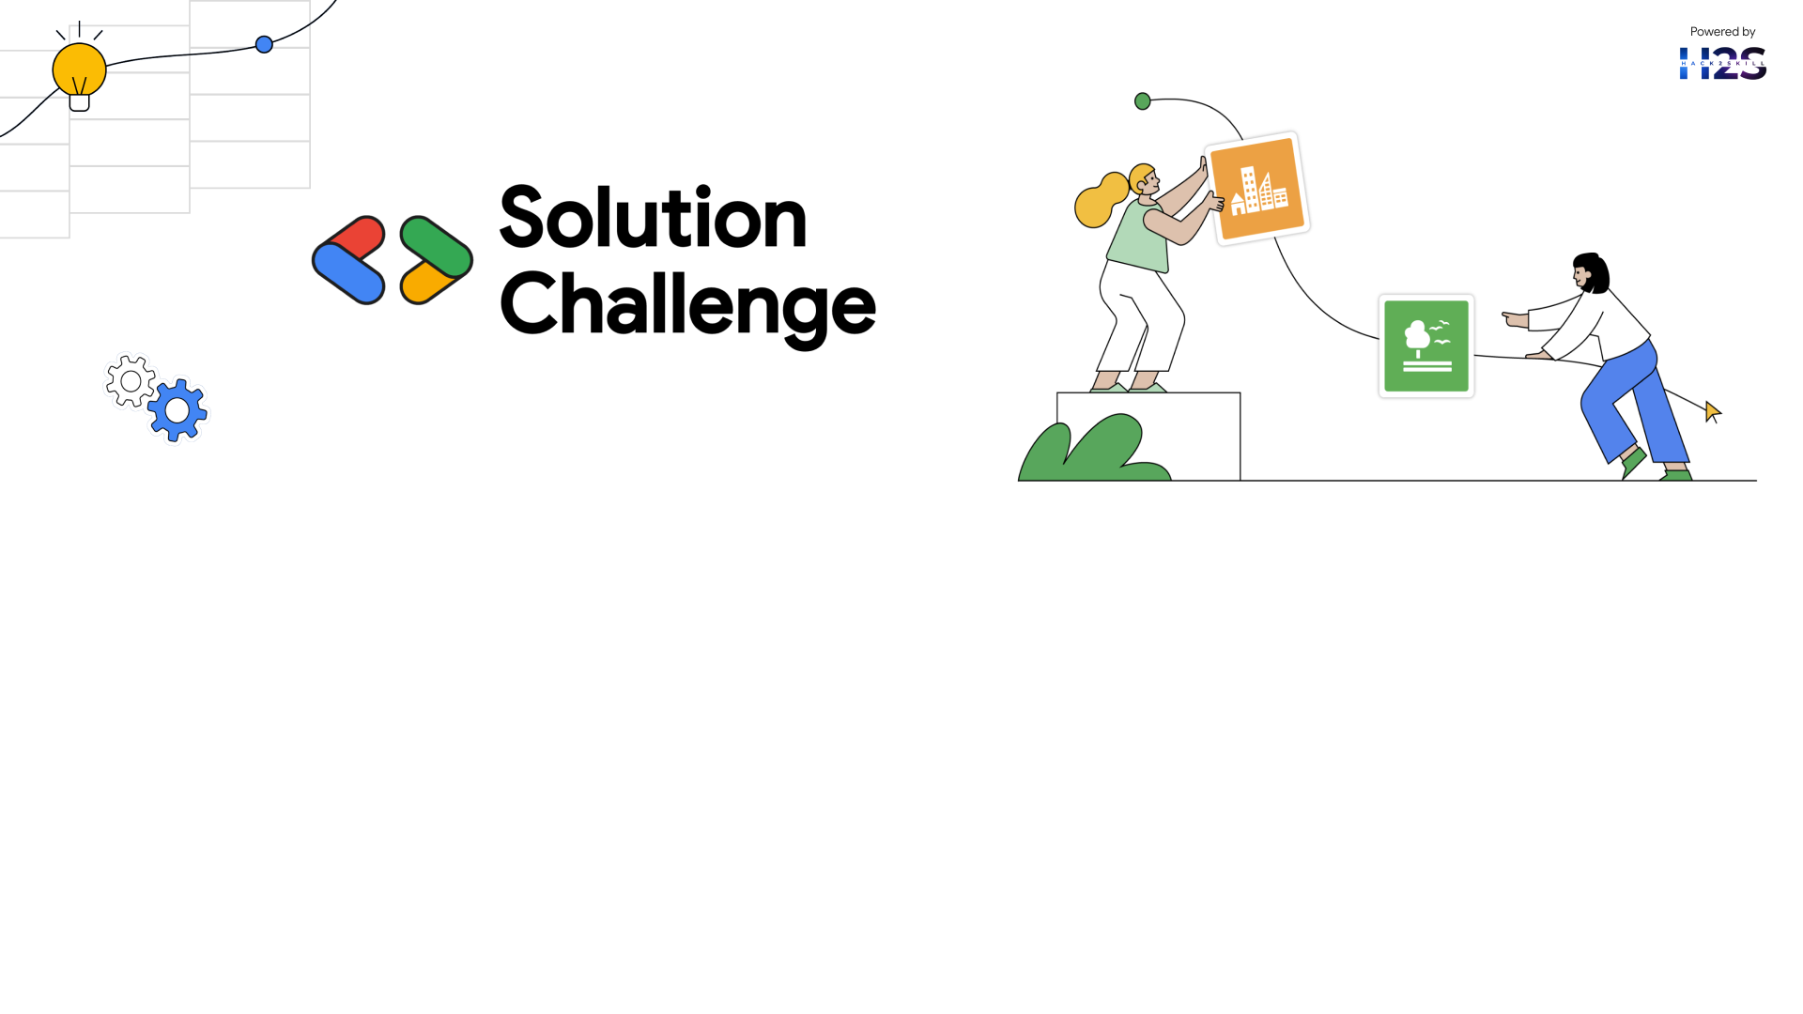
Team Details
Team name: BYTE SQUAD (Jamia Hamdard, New Delhi)
Team leader name: ABDUL MANNAN
Team Members : Ahmad , Zainab , Zoha , Mannan
Problem Statement: Revolutionizing voting with faster and secure automated verification.

Slide 2

Brief description about our solution
Our project is a secure, user-friendly online voting platform that empowers citizens to vote from home with confidence. Built with AIOHTTP (backend) and SQLite (database), it ensures speed, reliability, and data integrity.
To prevent fraud, we’ve implemented robust authentication and security measures. A key innovation is our Gemini AI chatbot, which guides users through the voting process, making it easy, even for first-time voters.
Additional features include:
🌙 Dark mode for visual comfort
♻️ Paperless and eco-friendly design
🔐 Real-time ID verification
By eliminating paperwork and enabling secure digital participation, this platform has the potential to transform how elections are conducted offering a scalable, future-ready solution for democratic engagement.

Slide 3
Opportunities
How Is It Different?
Speed & Efficiency Traditional systems use manual checks and paperwork. Our system features real-time automated verification, eliminating delays and reducing human error.
Security & Fraud Prevention Existing systems are prone to tampering and duplicate votes. We use secure ID checks to ensure each vote is genuine and traceable.
Accessibility & Scalability Many systems require in-person voting or special devices.
Ours supports remote voting with robust authentication ideal for rural areas, NRI voters, or people with disabilities.
Eco-Friendly
Paper ballots lead to waste and environmental impact.
Our digital approach promotes sustainability by going completely paperless.

Slide 4
How It Solves the Problem
Stops Voter Fraud Uses biometric checks and secure records to prevent fake IDs and duplicate votes.
Builds trust through transparent, verifiable processes.
Speeds Up Verification AI verifies voter details instantly from govt databases. Automated ID scanning (QR, NFC) cuts down wait times. Real-time verification removes manual bottlenecks.
Guided User Experience
Gemini AI chatbot assists users throughout the voting process.
Makes the platform beginner-friendly and accessible for all.
Prevents Double Voting
Each Aadhaar-linked vote is uniquely logged.
Ensures one person, one vote—no duplicates.
USP of the Proposed Solution
Instant & Automated Verification
AI-based ID checks (from govt database) replace manual verification cutting wait times and errors.
Secure & Fraud-Proof Voting
Strong authentication ensures only eligible voters can access the system, blocking impersonation and fake votes.
Accessible for All
Supports voting via mobile, kiosks, and biometrics ideal for remote regions and differently-abled users.
Scalable & Cost-Effective
Integrates easily with government systems, reducing costs while boosting speed and efficiency.

Slide 5
List of features offered by the solution
Seamless Integration with Existing Systems
• Easily connects with government Aadhaar databases for ID verification
• No need for new hardware or infrastructure
Strong Data Privacy & Security
• End-to-end encryption ensures secure vote transmission
• Strict access control on databases using aiosqlite for secure data handling
• Vote records are tamper-proof, and each Aadhaar ID can only be used once
Real-Time Monitoring & Analytics
• Tracks total votes and displays vote share (%) for each party
• Admins can view stats instantly using /votes API
• Prevents duplicate voting through live checks
Fast & Automated Voter Verification
• Aadhaar and Voter ID are auto-validated via database lookups
• Manual paperwork and ID checks are eliminated, reducing queues
• Each user gets one vote, tracked by their Aadhaar ID
AI Chatbot Support for Voter Assistance (Gemini Integration)
• Gemini chatbot guides users through the voting process step-by-step
• Improves accessibility and usability for new or confused voters
• Answers questions, explains party options, and provides real-time help

Slide 6
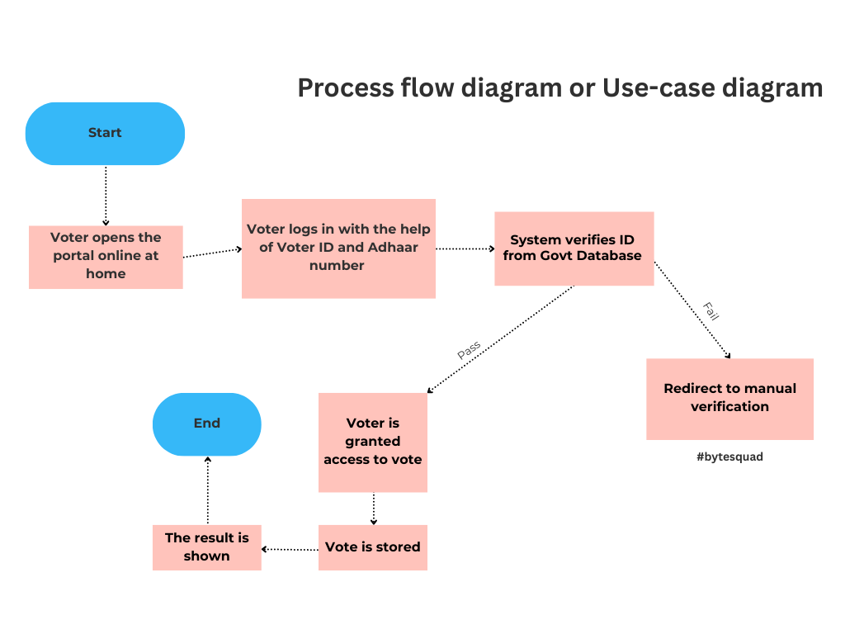

Slide 7
Technologies used in the solution
1. Frontend:
HTML
CSS
JAVASCRIPT
2. Backend:
SQLITE
PYTHON
AIOHTTP
3. Chatbot:
Gemini API
Gemini Model - gemini-1.5-pro
# note : we couldn’t migrate the project to Project IDX because of CORS error

Slide 8
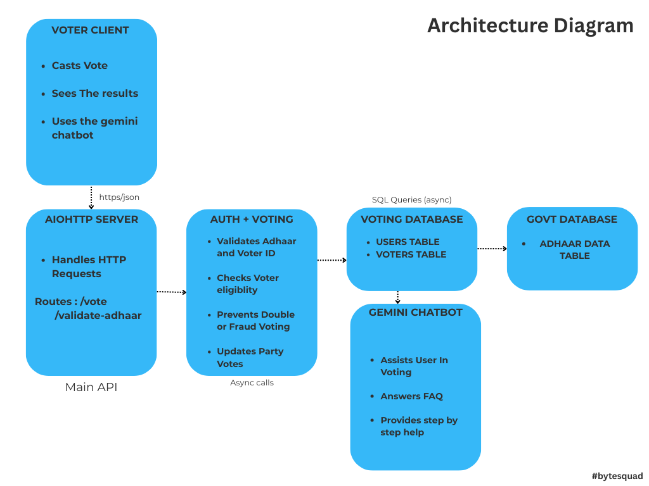

Slide 9
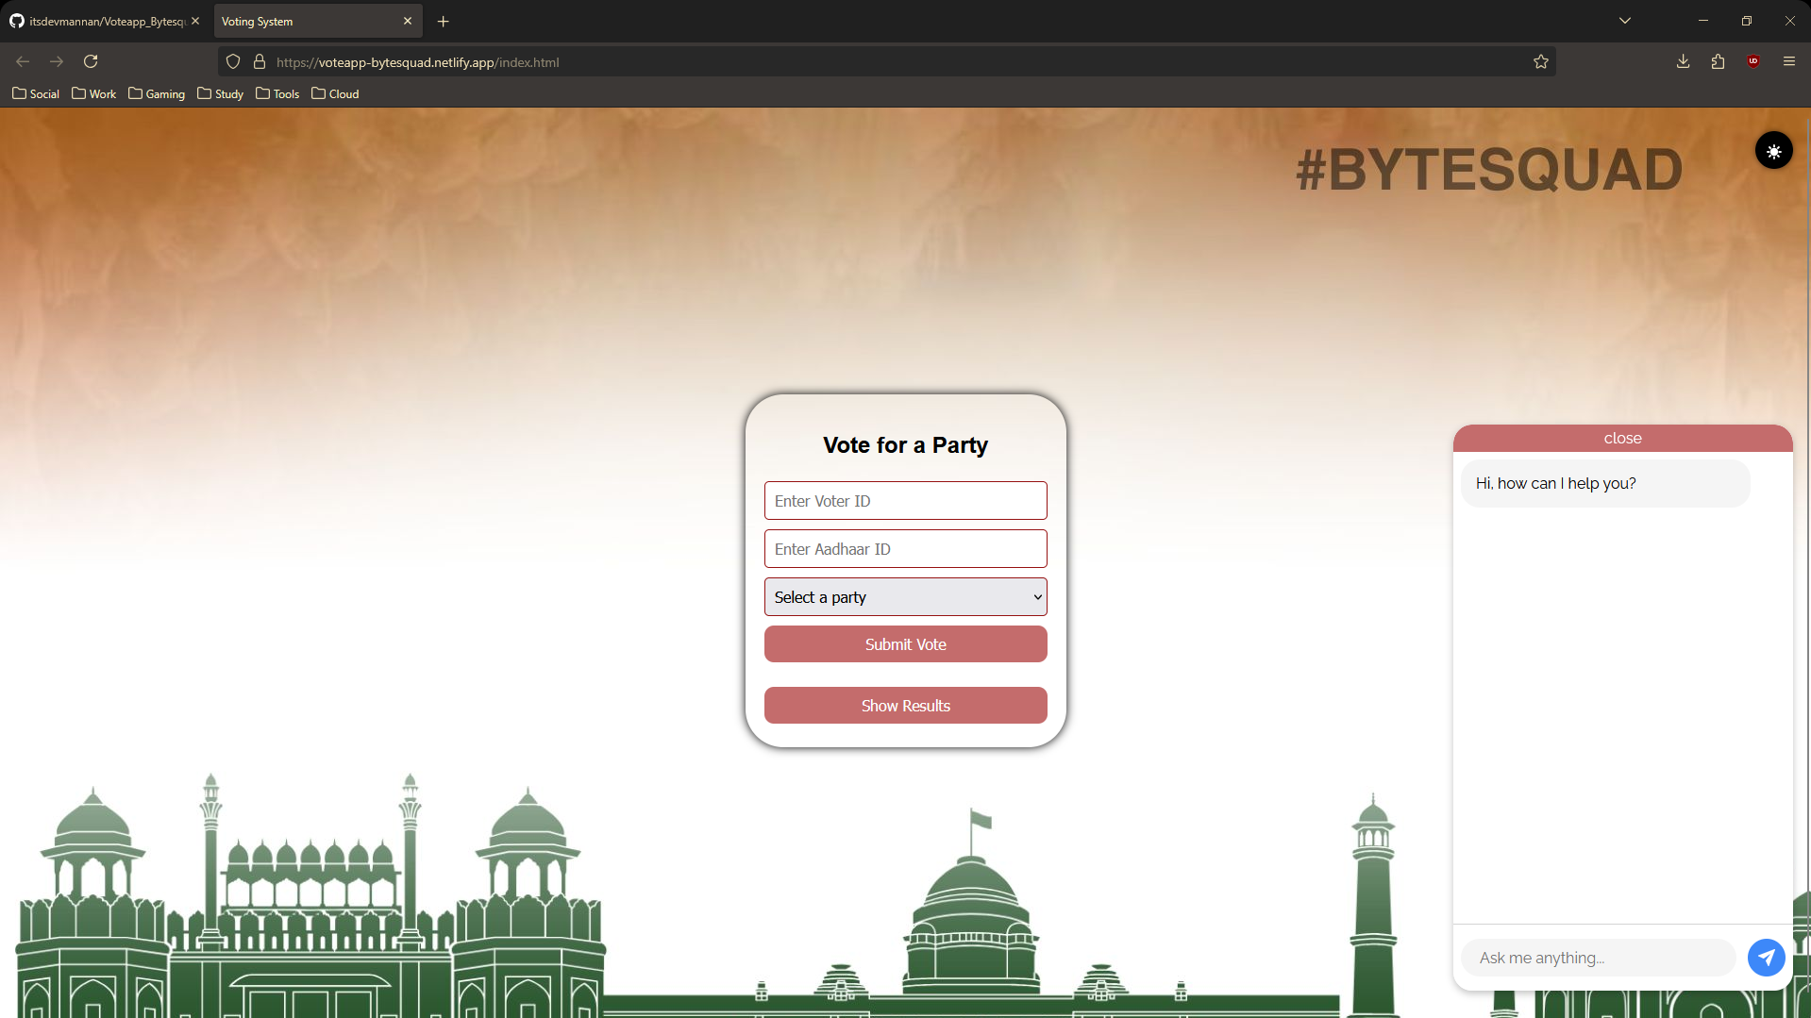
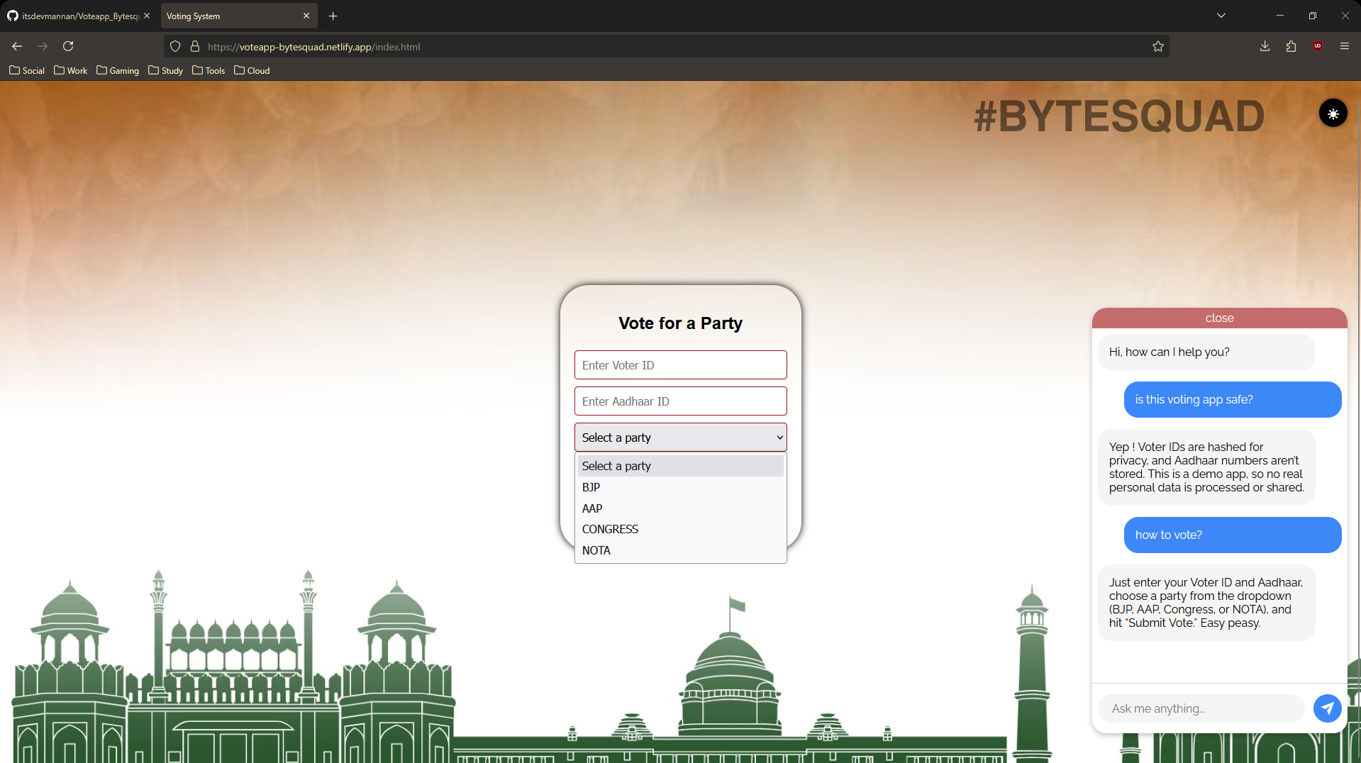
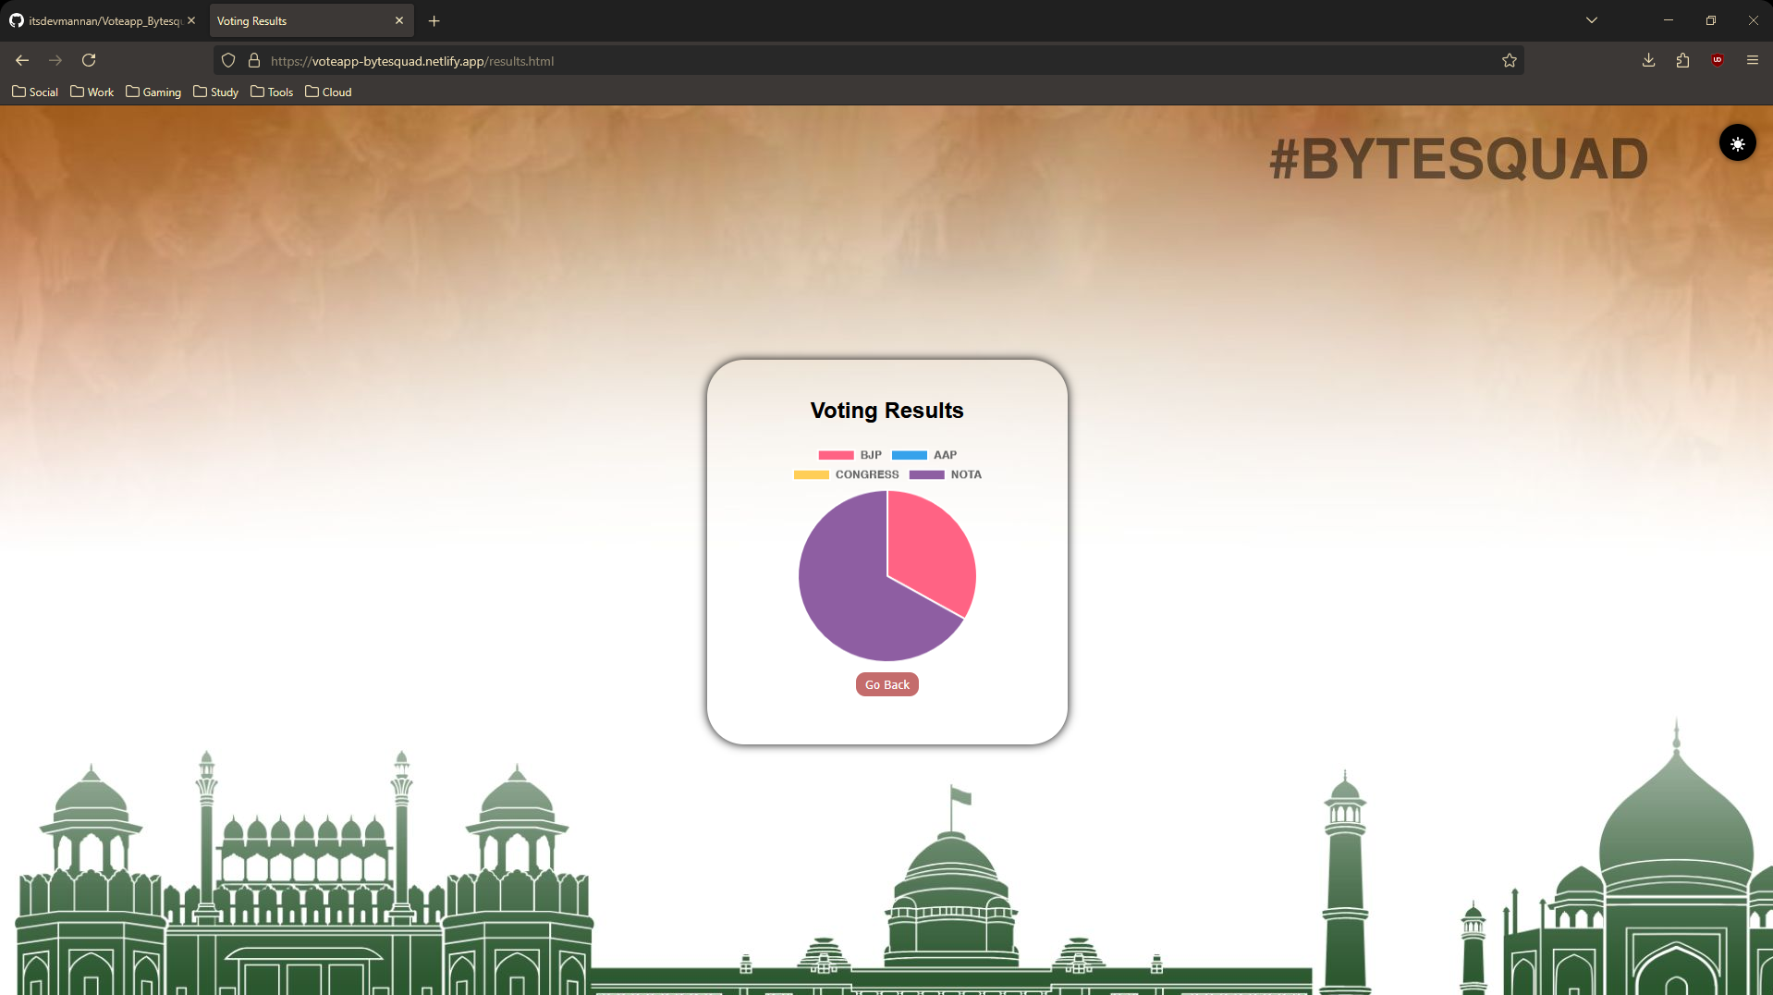
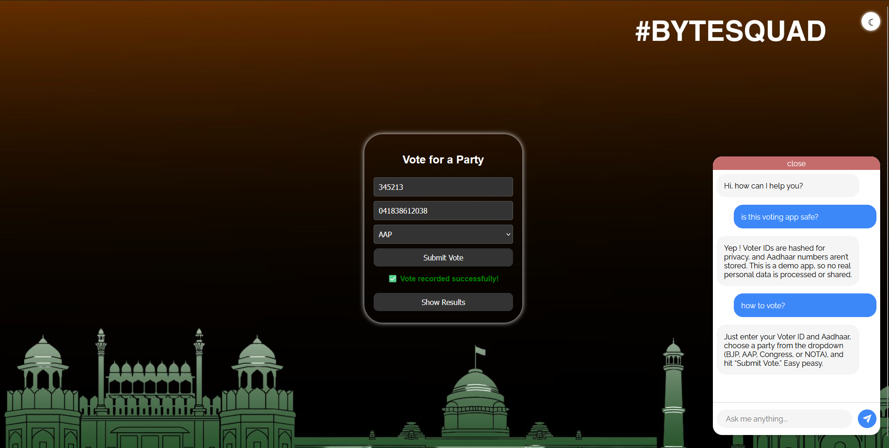
Snapshots of the MVP
Voting Login Interface
Gemini AI chatbot for assistance
Results Page After Vote Submission
Dark Mode + Vote Submission after input is verified from dummy govt database

Slide 10
Additional Details/Future Development (if any)
Government-Level Deployment
• Hosting the application on secure, government-backed infrastructure
• Ensuring compliance with national digital governance standards
Enhanced Cybersecurity Measures
• Implementing advanced security protocols (e.g., intrusion detection systems, rate limiting)
• Periodic vulnerability testing and penetration audits before final deployment
• Integration of multi-factor authentication and biometric-based access layers
Links:
GitHub Public Repository
Demo Video Link - Youtube
MVP LINK (Instructions Provided In github README.md)

Slide 11
